Slide 2

Workshop 2 & 3. Set up Dev Environment & API Basics
Set up Python
Set up Django project
Build your first API
A simple UI
Assignment

Slide 3

Integrate LLM service using Python
Logistics
Holiday – The President Day (Feb. 17 Monday)
We will have a day off and our next session, session 3 will be deferred to the week after – Feb. 24.
The total number of sessions stay the same. We will finish the project one week later.
Contact me if you have any questions.

Slide 4
Integrate LLM service using Python
Project overview
Request
Auto-reply email App
LLM
User
Response
Application Y
"Thanks for your email. I will get back to you soon. Regards, Yuan"

Slide 5
Workshop 2. Set up Dev Environment
Set up Python
Set up Django project
Build your first API
A simple UI
Assignment

Slide 6
Integrate LLM service using Python
1. Set up Python
Install Python
/bin/bash -c "$(curl -fsSL https://raw.githubusercontent.com/Homebrew/install/HEAD/install.sh)"
brew install python
python --version
Set up virtual environment
mkdir email_auto_reply_project && cd email_auto_reply_project
python3 -m venv venv
source venv/bin/activate (Activate the virtual env. Mac/Linux)
venv\Scripts\activate (Windows)
python3
deactivate (to exit the virtual env)

Slide 7
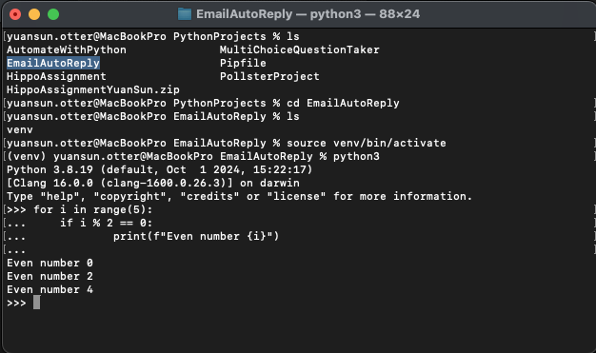
Integrate LLM service using Python

Slide 8
Integrate LLM service using Python
About Python
What is Python virtual environment?
A Python virtual environment is an isolated workspace where you can install and manage Python libraries separately from the system-wide Python installation. This helps avoid conflicts between different projects that require different dependencies.

Slide 9

Any questions?

Slide 10
Workshop 2. Set up Dev Environment
Set up Python
Set up Django project
Build your first API
A simple UI
Assignment

Slide 11
Integrate LLM service using Python
2. Set up Django
Install Django in virtual environment
brew install pythonpip install django
django-admin --version
Create a Django project
django-admin startproject email_auto_reply_project
cd email_auto_reply_project
Run the Development server
python manage.py runserver
Apply Migrations (Database Setup)
python python manage.py migrate

Slide 12
Integrate LLM service using Python
About Django
What is Django?
Django is a Python web framework for web applications. It follows the Model-View-Template (MVT) architectural pattern.
Components
Models – Defines the structure of your database tables.
Views – Contains the logic that processes requests and returns responses.
Templates – HTML files with embedded Django Template Language (DTL) to render dynamic content.
URLs – routing defines how web requests are mapped to views.

Slide 13
Any questions?

Slide 14
Integrate LLM service using Python
3. Set up project
Register the App in Settings
To use the app in your project, you need to add it to your settings. Open myproject/settings.py and find the INSTALLED_APPS list. Add 'myapp' to this list:
INSTALLED_APPS = [..., 'email_auto_reply_project']
Create a View for Your App
Now, let’s add a simple view to show something on the homepage.
Open myproject/urls.py and include your app’s URLs like this:
urlpatterns = [..., path('', views.home, name='home'),]
In myapp/views.py, add the following code:
from django.http import HttpResponse
def home(request):
return HttpResponse("Hello, Django!")

Slide 15
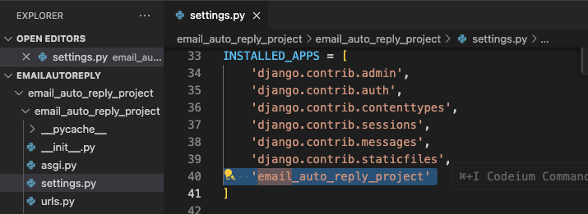
Integrate LLM service using Python

Slide 16
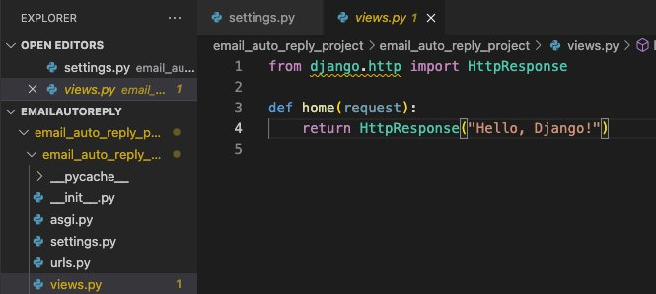
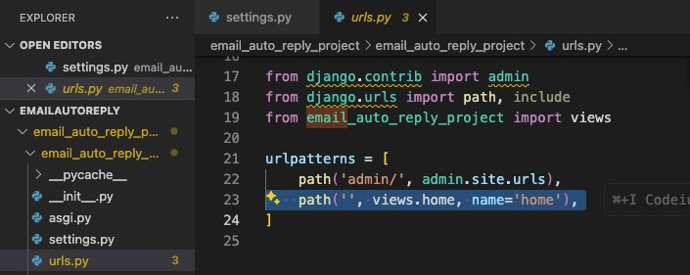
Integrate LLM service using Python

Slide 17
Integrate LLM service using Python
4. Test the project
Now, run the server again
python manage.py runserver
Go to http://127.0.0.1:8000 in your browser.
You should see "Hello, Django!" displayed on the page.

Slide 18
Any questions?

Slide 19
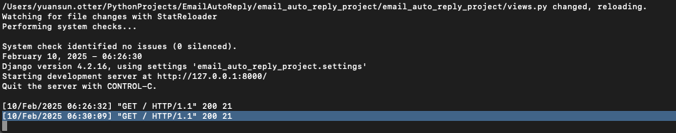
Integrate LLM service using Python
5. Quiz
Make code change so that the home page greetings your classmates.
"Hello from Open Avenues Build Project!"
Refresh the page,
What do you see in the terminal?
What does it mean and where it's coming from?

Slide 20
Integrate LLM service using Python
Pausing... and recap
What is a View?
What is an URL?

Slide 21
Any questions?

Slide 22
Workshop 3. API Basics
Set up Python
Set up Django project
Build your first API
A simple UI
Assignment

Slide 23
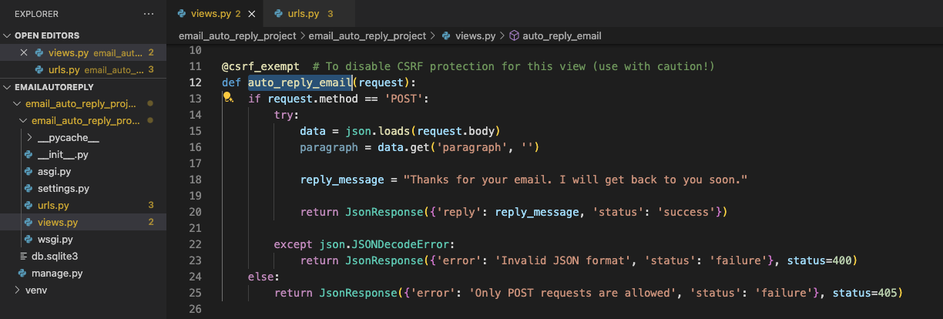
Integrate LLM service using Python
6. Build our first API
Define the View
In your myapp/views.py, create a new view called auto_reply_email that takes a paragraph of text (using the POST method) and returns the auto-reply message.

Slide 24
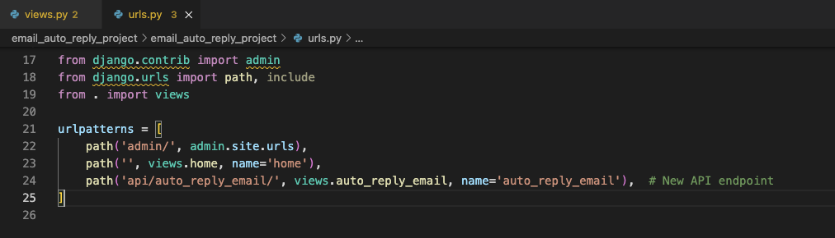
Integrate LLM service using Python
6. Build our first API
Add a URL for the API

Slide 25
Integrate LLM service using Python
6. Build our first API
Test via shell
curl -X POST http://127.0.0.1:8000/api/auto_reply_email/ -H "Content-Type: application/json" -d '{"paragraph": "Hi, I have a question regarding my order status. Could you please help me?"}'

Slide 26
Integrate LLM service using Python
About API
What is API?
Application Programming Interface
Request
Response

Slide 27
Any questions?

Slide 28
Set up Python
Set up Django project
Build your first API
A simple UI
Assignment

Slide 29
Integrate LLM service using Python
7. Surface it to user
Make it on the web page
Now, create a new HTML template called home.html in the myapp/templates directory (if it doesn't already exist).
Define the layout of the page and button in the html file.

Slide 30
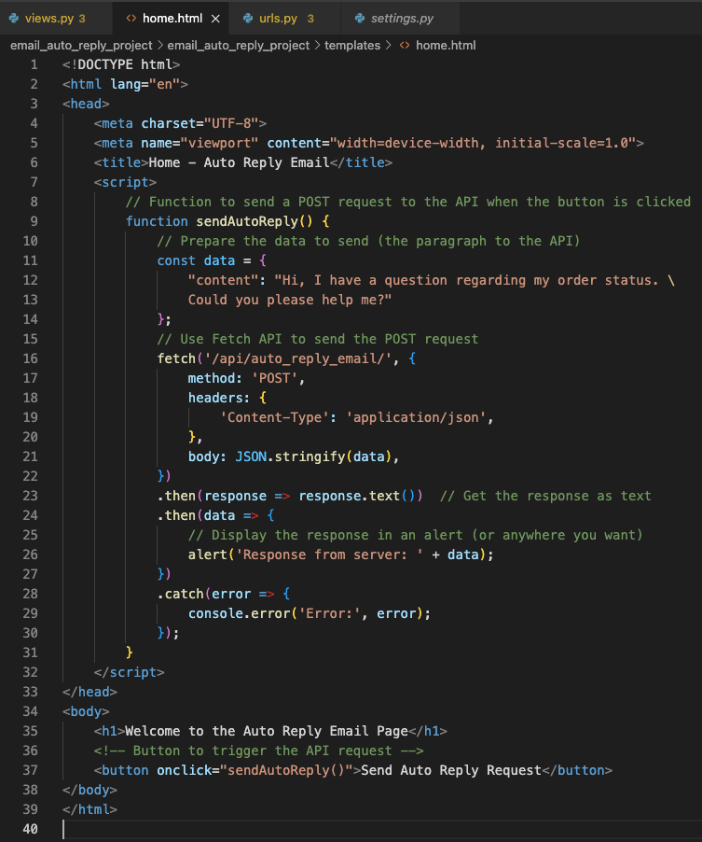
Integrate LLM service using Python
7. Surface it to user
Make it on the web page
HTML template

Slide 31
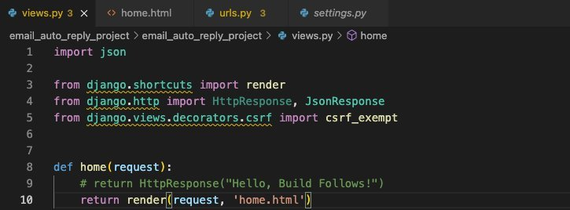
Integrate LLM service using Python
7. Surface it to user
Make it on the web page
Update the Home View to Include the Button
In your myapp/views.py, modify the home view to render a template that contains the button. Here’s an example of the updated home view:

Slide 32
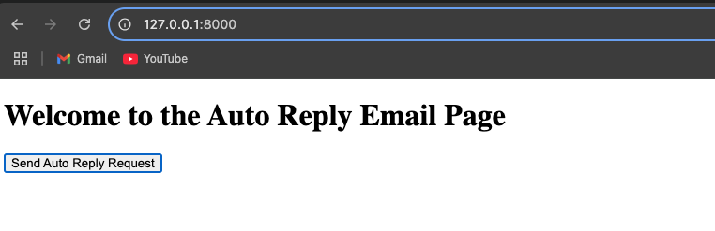
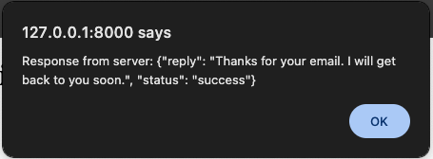
Integrate LLM service using Python
7. Surface it to user
Make it on the web page

Slide 33
Any questions?

Slide 34
Set up Python
Set up Django project
Build your first API
A simple UI
Assignment

Slide 35
Integrate LLM service using Python
8. Assignment
Make changes to the application
Provide an input box on the home page for user to enter the email paragraphs.
After user clicks the submit button, they should get a auto reply response printed on the home page output box.
The replied message should contain the email sender's name.
Assume all inputs have sender name attached at the end.
Example input
"Hi Foo, I have a question regarding my order status. Regards, Bryan."
Expected output
"Hi Bryan, thanks for your email. I will get back to you soon. Best, Foo."

Slide 36
Integrate LLM service using Python
8. Assignment
Submit your work
Record a video demo
Show the user flow with input of an email copies and check the output.
Try a few different email copies demonstrate it works for all.
Explain your solution and algorithm for this product feature.
Video recording tool Loom: https://www.loom.com/
Attach your video link to the project workspace folder
"BP - Feb, 2025 - Workspace with students" -> "Student's Assignments" -> "Assignment 1. Feb. 10, 2025" -> "firstname_last_name_assignment_1.url"
Shared folder link

Slide 37
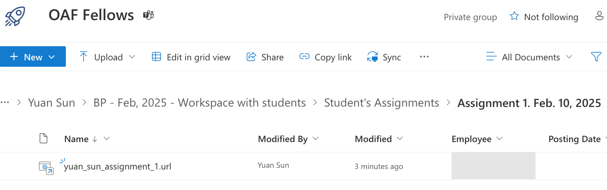
Integrate LLM service using Python
8. Assignment
Submit your work

Slide 38
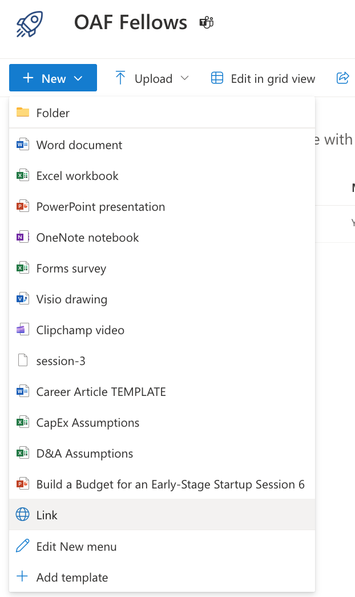
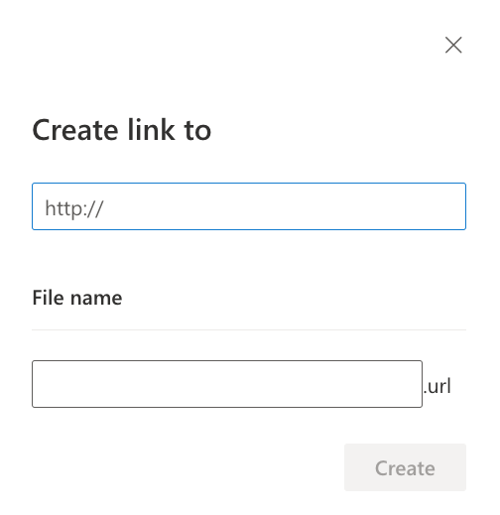
Integrate LLM service using Python
8. Assignment
Submit your work
Click "New" on the top left
Click "Link"
Attach your video link
Enter the file name

Slide 39
Workshop 2 & 3. Set up Dev Environment & API Basics
Set up Python
Set up Django project
Build your first API
A simple UI
Assignment

